Slide 1

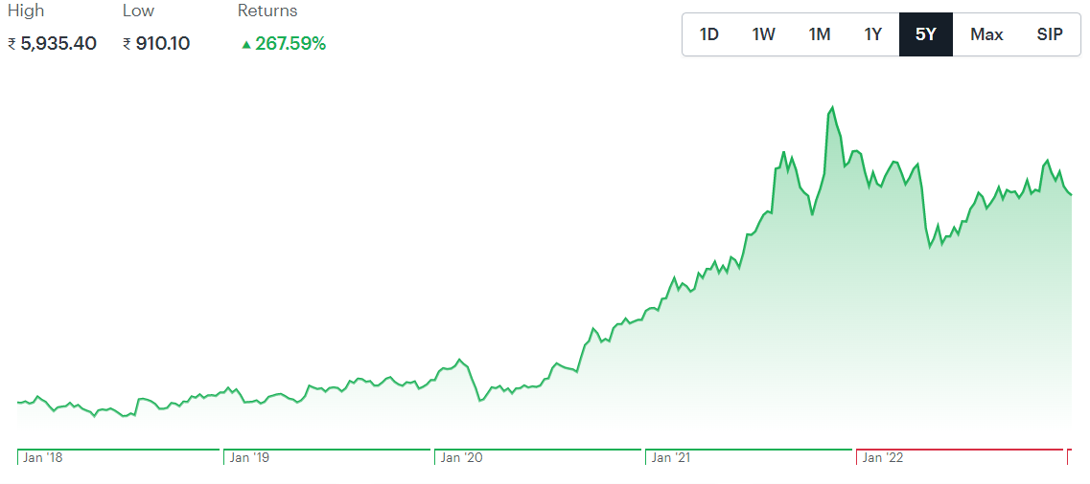
hjhg
As per the equity research given below one can consider Apollo Hospitals Enterprise Ltd stock as a long term investment as it is not as much volatile but have a good future in terms of growth and returns

Slide 2
Qualitative Analysis
I am going to do the equity research on Apollo Hospitals Enterprise Ltd being a leading company in providing healthcare facilities. The Company is engaged in offering healthcare services and operating as standalone pharmacies with operations worldwide.
This company belongs to Hospitals & Allied Services sector with a total market cap of Rs218150.4 crore and have grown significantly during the covid times.Healthcare has become one of the largest sectors of the Indian economy, in terms of both revenue and employment. It has been growing at a CAGR of 22% since 2016 and will grow to approximately 400 billion dollars by 2024.

Slide 3
Growing Potential of Sector
India’s healthcare industry comprises hospitals, medical devices and equipment, health insurance, clinical trials, telemedicine and medical tourism.
These market segments are expected to diversify as an ageing population with a growing middle class increasingly favours preventative healthcare.
Moreover, the rising proportion of lifestyle diseases caused by high cholesterol, high blood pressure, obesity, poor diet and alcohol consumption in urban areas is boosting demand for specialised care services.
In addition to these demographic and epidemiological trends, COVID-19 has changed people attitudes towards personal health and hygiene, health insurance, fitness and nutrition as well as health monitoring and medical check-ups. The pandemic has also accelerated the adoption of digital technologies, including telemedicine.

Slide 4
Market Share of Different Companies In This Sector on NSE
Company Name | Market Share(in terms of market cap)
Apollo Hospital | 62338.56
Dr Lal Pathlabs | 18106
Kovai Medical | 1866
Max Healthcare | 43940

Slide 5
About Companies Management
Name Designation
Dinesh Madhavan President
K Hariprasad President
Krishnan Akhileswaran Chief Financial Officer
M B N Rao Independent Director
Murali Doraiswamy Independent Director
Prathap C Reddy Founder & Executive Chairman
Preetha Reddy Executive Vice Chairperson
Rama Bijapurkar Independent Director
S M Krishnan Vice President (Finance) & Co. Secretary
Sangita Reddy Joint Managing Director
Shobana Kamineni Executive Vice Chairperson
Som Mittal Independent Director
Suneeta Reddy Managing Director
V Kavitha Dutt Independent Director
Vinayak Chatterjee Independent Director

Slide 6
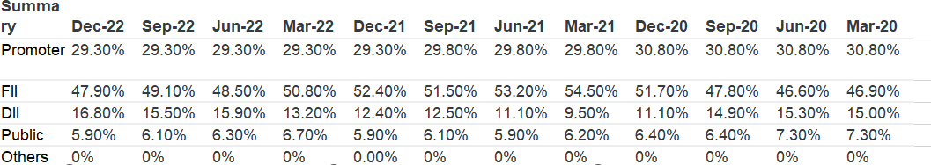
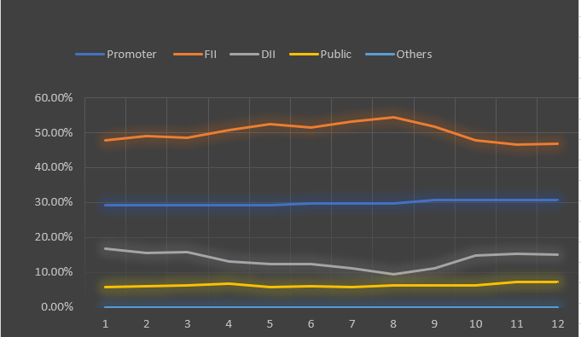
Shareholding Pattern

Slide 7
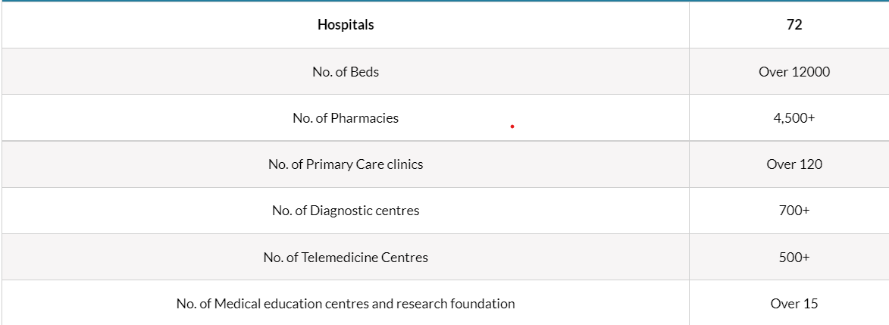
Companies Strength and differences

Slide 8
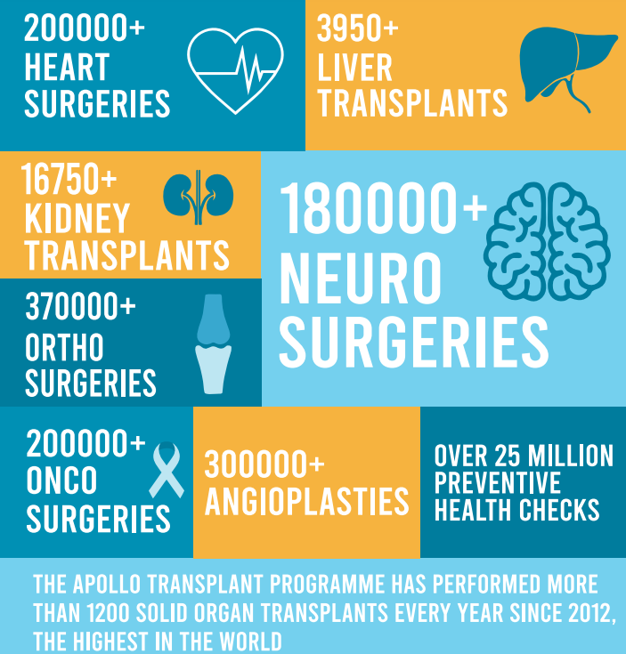


Brand Portfolio and Customer Services

Slide 9
Development
Apollo Hospitals, Chennai successfully performed over 50,000 cardiac surgeries which includes Bypass, Valve replacements, Pediatric cardiac procedures, Transplants and Minimally invasive procedures.
Asia’s first simultaneous Kidney-Pancreas Transplant was performed on a 38-year-old patient by Apollo Hospitals, Chennai.
The first ever Transfemoral Pulmonary Valve Implantation using an Indian-made valve, MYVAL, was performed by Apollo Hospitals, Chennai.
The first and the world’s largest Artificial Pulmonary Valve (32mm) was implanted without surgery by a team of doctors at Apollo Hospitals, Chennai.
India’s first successful combined cardiac and tracheal surgery was performed on 11-month-old baby from Oman by Apollo Children’s Hospital, Chennai.
India’s first Total Marrow Irradiation Procedure was performed on a 35-year-old patient from Oman by Apollo Proton Cancer Centre, Chennai.

Slide 10
Company Business Segment
The main segment of the company that create revenue for the company is by surgeries,body organ transplants,treatment of cancer patients.,pharmacy business
Expansion in Research Field
IIT Kanpur and Apollo Hospitals join hands for research collaboration in cutting-edge medical technology.
Apollo Hospitals has launched an automated AI based real-time rapid-response patient monitoring system, Enhanced Connected Care.

Slide 11
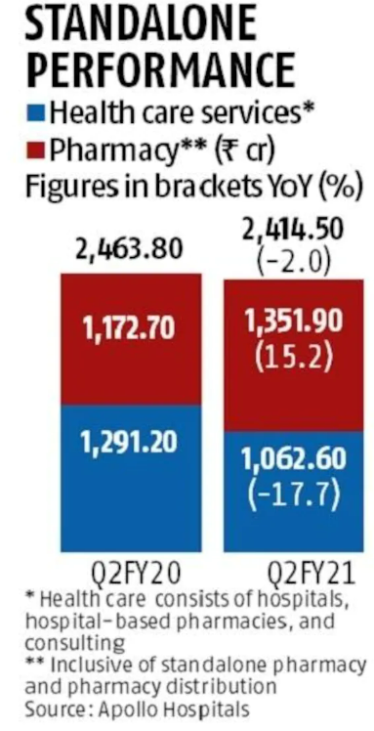
Future Plans
Apollo Hospitals Enterprises (AHEL) is planning to raise around Rs 1,500 crore in the next two months to support its inorganic growth and strengthen balance sheet and its digital platform
Apollo Hospitals' plans about expanding its digital business, which is touted to be the fastest growing
Chennai-based corporate hospital network, Apollo Hospitals is planning to expand its reach in the east and north geographies of the country by acquiring small and mid-sized hospitals, further adding to its portfolio of healthcare facilities.
The company has crossed the 5 million registered user mark for digital platform Apollo 24/7, undertaking more than 2,600 teleconsultations every day. It has plans to further increase emphasis on digitisation, automation and robotics in line with global best care practices and expands capabilities in Artificial Intelligence in preventive health and clinical decision support.

Slide 12
Quantitative Analysis
Profit Growth in Last 5 years

Slide 13
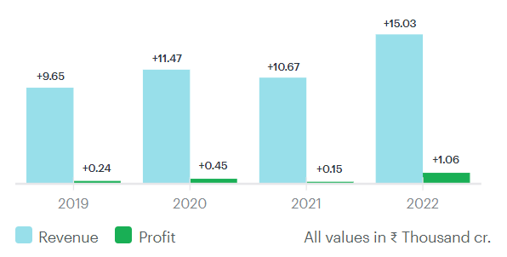
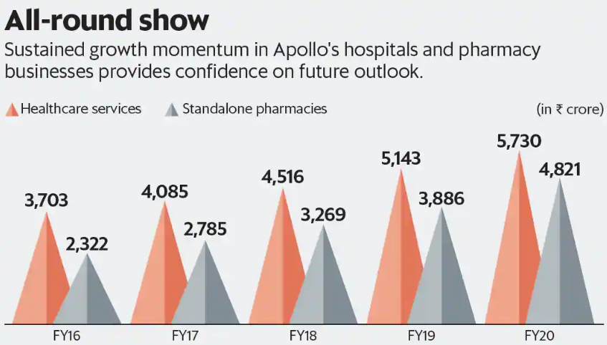
Profit and Sales Graph

Slide 14
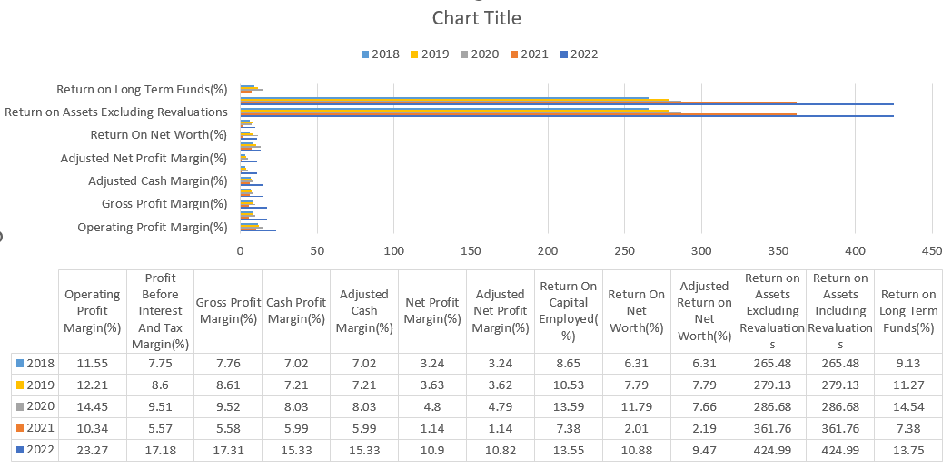
Profitability Ratio of previous 5 years

Slide 15
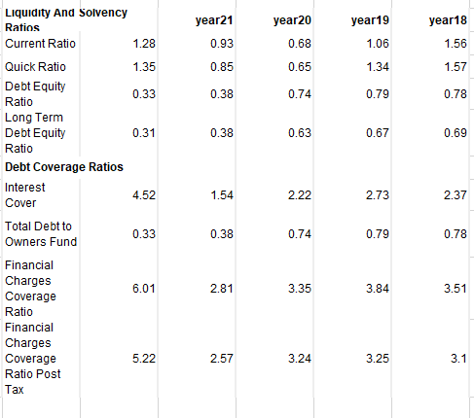
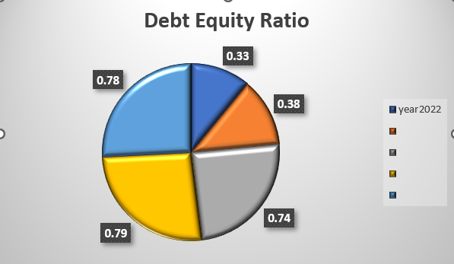
Leverage Ratio

Slide 16
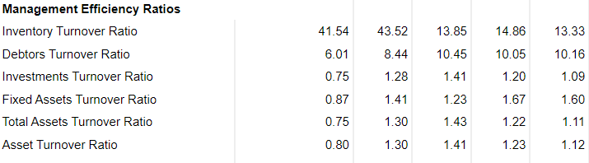
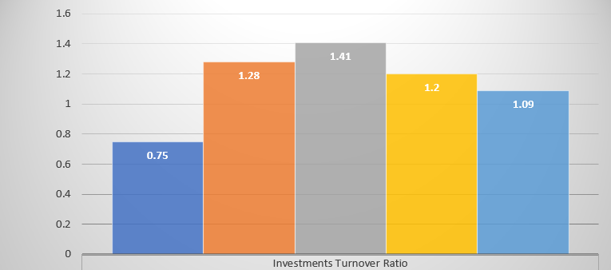
Management Efficiency Ratio

Slide 17
Valuation Ratio of Company and Sector
The whole health market is growing at significant rate after the Covid time as people gets more concerned towards their health issues and the its effect can also be seen in the health companies stocks

Slide 18
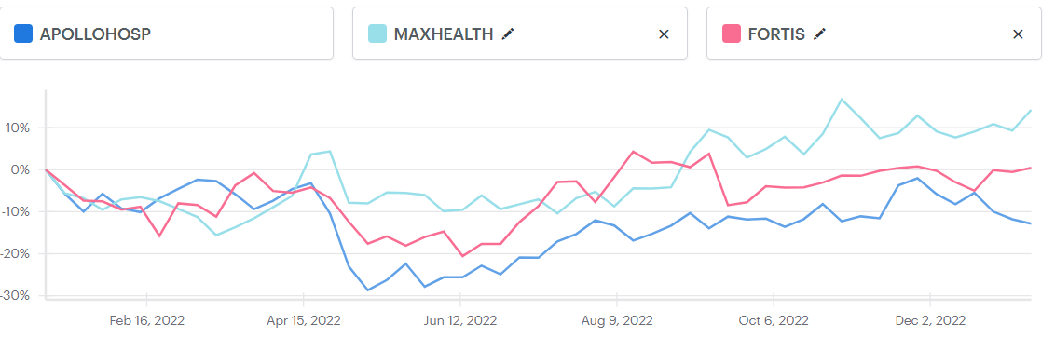
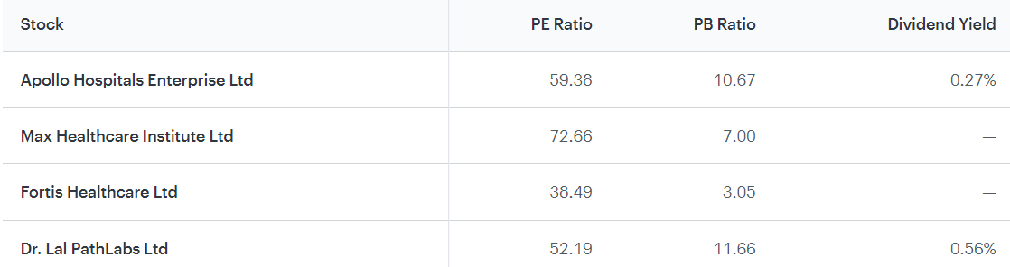
Peer Comparison
The Apollo Company has highest market share but there are some significant peers.
Financial Ratio Comparison with peers

Slide 19

Concerns
Apollo Hospitals is a healthy option for long-term investors as per
Expansion potential in digital platform, steady growth in traditional business and value unlocking in pharmacy segment are key positives.
Analysts expect standalone pharmacy additions, rising sales of private labels (own brands), separation of pharmacy front-end business, focus on online pharmacy business to continue driving growth, and helping margin expansions.
Analysts have suggested that investors can buy this stock

Slide 20


